Slide 1
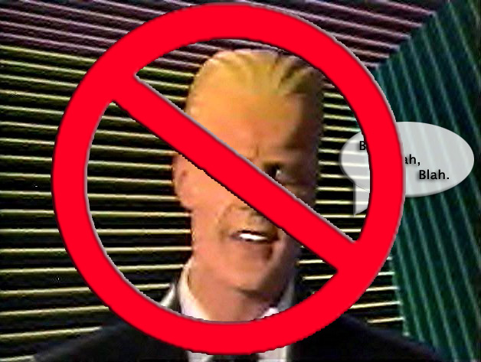
Beyond the Talking Head:
The Art of Digital Storytelling
Sarah Greer Osborne
Director of Communications
Houston, TX

Slide 2
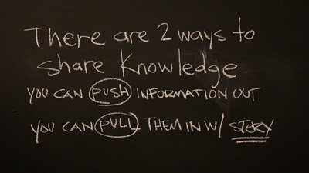
Storytelling:
Most powerful way to get message across
Good stories can change mindsets and opinions
EVERYONE has a story

Slide 3
My story:
Mom
Wife
Public-ed supporter
Former TV reporter, anchor, and producer
Lifelong storyteller

Slide 4
What’s the REAL STORY?
Ask questions
Dig deeper
Build relationships
Get out of the office and into the trenches

Slide 5
First person narratives:
LINK: https://vimeo.com/106301142
Spend time with the subject without the camera
May take several interviews
Match pictures to what they’re saying
Have others “describe” them
It’s impossible to fit everything in

Slide 6
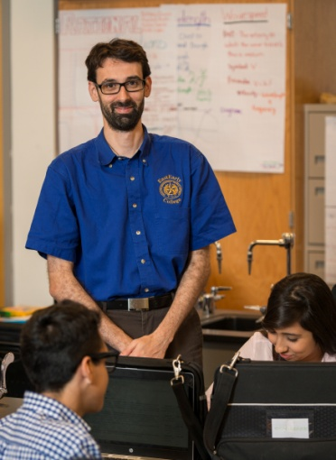
Using multiple storytellers:
LINK: https://vimeo.com/96242515
Remember your audience
Ask similar or same questions to every subject
Weave voices together into concise story
Shorter sound bites are better
(5-15 sec)
Don’t forget kids!

Slide 7
Talking Heads: How to make the best of it
LINK: https://vimeo.com/109604309
Add words, graphics or both
Use music
Short, concise sound bites
If long sound bite, break it up with:
natural sound, music, another person’s voice
Get those in the trenches
Add student voices

Slide 8
When using a narrator:
LINK: https://vimeo.com/119272795
Choose your words carefully
Concise, short sentences or thoughts
Don’t overwrite
One or more narrators?
Use voice of narrator to weave
together sound from interviews

Slide 9
When to use graphics?
LINK: https://vimeo.com/88199355
When story is complicated
Has multiple parts and lots of info
To help viewer understand
When video or interviews are limited
Utilize graphic artist if you can

Slide 10
Sometimes less is more
Do you need to interview anyone?
Do you need a narrator?
Can the pictures or graphics tell the story?
Think outside the box
LINK: https://vimeo.com/126620159

Slide 11
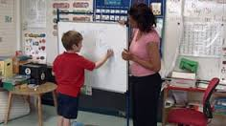
Sometimes you need a host
CIA: Caught in the Act Video Series:
Recognizes one teacher per month
Highlights great instruction
Principals use for teacher PD
Bringing awareness to competencies of HISD “Global Graduate” profile
Hosted by Elementary and Secondary Curriculum and Instruction Officers
LINK:
https://vimeo.com/125480889
https://vimeo.com/129595061

Slide 12
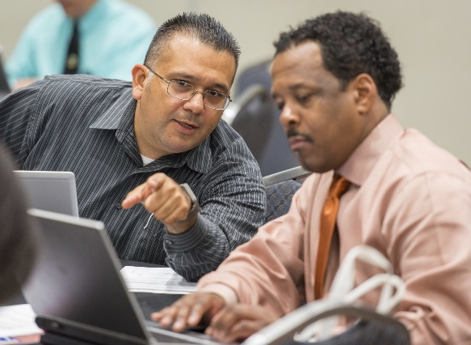
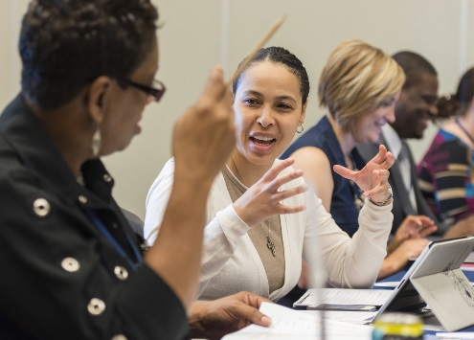
Think internally
Employee relations
Get buy-in for new programs
Use early adopters to win other teachers over
Power of peer-to-peer persuasion
LINK: https://vimeo.com/116268476

Slide 13
Use staff to recruit https://vimeo.com/126252273#at=0 https://vimeo.com/124536614
Don’t forget your biggest fans
(parents, alumni, and community members)
https://vimeo.com/83594750

Slide 14
Questions?

