Slide 1
Influencing Opinions: Keeping the Focus on Student Achievement
Council of the Great City Schools Public Relations Executives Meeting
July 6, 2013

Slide 2
Focusing on Students: Overview
Public Opinion
District Statistics & Philosophy
How We Focus on Students
Metrics
Return on Investment
Comments & Questions

Slide 3
Focusing on Students
The Importance of Positive Public Opinion for School Districts:
Builds trust in public education
Impacts policy-making
Generates support of taxpayers
Maintains and increases enrollment
Increases community and business engagement
Generates interest and support from funders
Builds local economy

Slide 4
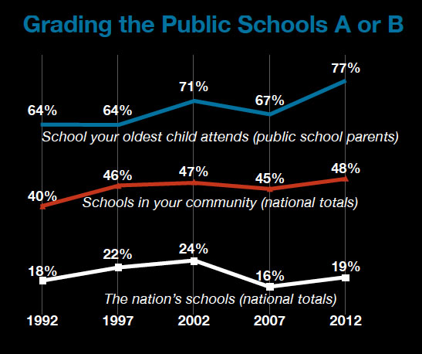
Focusing on Students: Public Opinion
2012 Phi Delta Kappa/Gallup Poll on how Americans view public education:
Americans give relatively high grades to the public schools in their own communities. In 2012, 48 percent gave them a grade of an A or B, compared to 40 percent in 1992. But they give lower to grades to public schools in the nation as a whole; only 19% gave an A or B. www.pdkpoll.org

Slide 5
Focusing on Students: Facts
131,541 students
2nd largest district in California
228 total educational facilities
118 elementary schools, including K-8
24 middle schools
28 high schools
13 atypical schools
45 charter schools
80% of persons who live within the district boundaries do not have children who attend our schools.
65% Free & reduced-price lunch eligible
16,062 Students with disabilities
9,745 students from military families
More than 27,643 students participate in the Gifted and Talented Education (GATE) program
1,301 Foster youth enrolled

Slide 6
Focusing on Students: Diversity
Student Diversity
45.7% Hispanic
23.9% White
15.2% Asian
11.8% African-American
3.1% Multi Racial/Eth.
0.4% Native American
Home Languages
30.2 % English learners
Over 60 languages spoken

Slide 7
Focusing on Students: Budget Cuts
Multiple Years of Budget Cuts:
More than $500 million cut over last 5 years
Board directive: Keep cuts as faraway from the classroom as possible
Cuts: reduced school year; increased K-3 class size; elimination of GATE, outdoor programs and bus service for 4,000 students; school supplies cut by 25+%
Staffing cuts: 13% staff reductions, mainly classified staff (50% staff reduction in Communications Dept.)

Slide 8
Focusing on Students: Mission
“All San Diego students will graduate with the skills, motivation, curiosity and resilience to succeed in their choice of college and career in order to lead and participate in the society of tomorrow.”
--2008

Slide 9
Focusing on Students: Mission
What Next?

Slide 10
It Began With A Vision

Slide 11
Focusing on Students: Vision 2020
Creating Improved and Broader Measures of Student Achievement
Developing Schools as Neighborhood Learning Centers
Ensuring Effective Teaching in the Classroom
Engaging Parents and Community
Facilitating Communication and Support Across the District

Slide 12
Focusing on Students: All Employees
Vision 2020 connects learning and business:
Certificated (Instructional) Employees
Provide broad and challenging curriculum
Quality Teaching
Quality Leadership
Professional Learning for All Staff
Closing the Achievement Gap

Slide 13
Focusing on Students: All Employees
Classified (Business) Employees
Food for Thought – Food Services
Driving Learning – Transportation
Building Minds by Minding Buildings – Physical Plant Operations.
Focus on Students – Communications Department

Slide 14
2008-2012 Academic Progress Goes UP, Funding Goes DOWN Recommitment to success for ALL students pays off
Focusing on Students - Milestones
Strategic Process
12 Indicators of a Quality School
Quality Teaching
Quality Leadership
Professional Learning
Closing the Achievement Gap with High Expectations for All
Closing the Achievement Gap with High Expectations for All
Parent and Community Engagement Around Student Achievement
Quality Support Staff
Valuing Diversity
High Enrollment of Neighborhood Students
Digital Literacy
Neighborhood Center
Supportive Environment, Safe and Well-Maintained Facilities
Moral Imperative
It is our moral imperative to prepare ALL San Diego Unified students to succeed in college and careers by creating conditions that will eliminate racial and economic disparity in student achievement.
Community Based School Reform
Five Pillars
Vision 2020
Professional Learning Communities
Data Informed Instruction
Parent Engagement
Goals for Student Achievement
VISION 2020
Sets 2020 Goals
Student Achievement
Schools as Neighborhood Centers
Parents Engagement
Effective Teachers
Supportive District Leadership
Focus Areas
2011/12/13
Professional Learning Communities
Parent Community Engagement
College Career Readiness
Quality Schools In All Neighborhoods
2008-09
-$90M
2009-10
-$93.1M
2010-11
-$134.6M
2011-12
-$82M
2012-13
-$120M

Slide 15
Focusing on Students: Academic Results
San Diego Unified …
Steadily Improving Test Scores
Attendance Rates Gains
Reduction in Drop-out Rates
Increase in Graduation Rates
Good News to Share with Public

Slide 16
Focusing on Students: How We Do It
School Websites (156/183)
Facebook
Spanish
RSS Graffiti
Website
Content/Photos
Blog
Spanish
FeedBurner
Hootsuite
Twitter
Friday Notes
Spanish
80K

Slide 17
Focusing on Students: Events
Student Culinary Services
Teacher of the Year
Classified Employee of the Year
Student Entertainment
Teacher of the Year
Classified Employee of the Year
Volunteer Appreciation Event
Salute to Excellence
Retiree Celebration
Board of Education Meetings
Student Involvement
Ribbon Cuttings & Groundbreaking Ceremonies

Slide 18
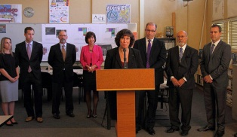
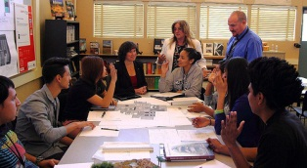
Focusing on Students: Media
Morning News Shows
Press Conferences

Slide 19
Strategy Benefits
Focusing on Students:
Shape Public Opinion
Benefits Students
Boost Employee Morale
Feed Public Desire

Slide 20
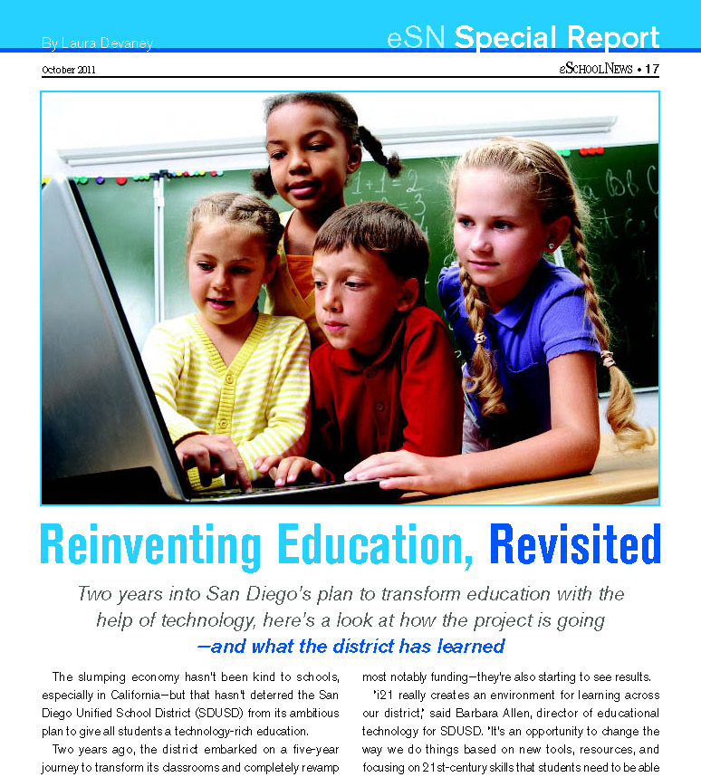
Focusing on Students: Metrics
Get the biggest bang for your buck.
80 percent of voters don’t have students in schools.

Slide 21
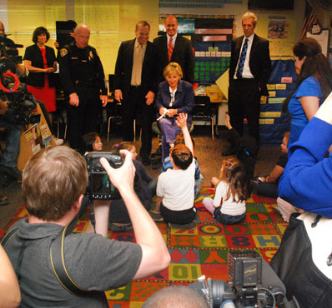
Focusing on Students: Metrics
Website, Social Media
Website usage
San Diego Unified home page: 300,000 visitors a week
Facebook, Twitter Likes and Fans
San Diego Unified: Facebook, 3,000; Twitter, 6,500
Individual News Items
San Diego Unified: 250-1,000 views per news item
E-Newsletter Digest
Distributed to 85,000; average open rate is 15-20 percent

Slide 22
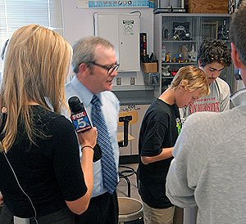
Focusing on Students: Metrics
Practice SEO – Search Engine Optimization
Regular posting of new stories
Reposting and linking to positive stories

Slide 23
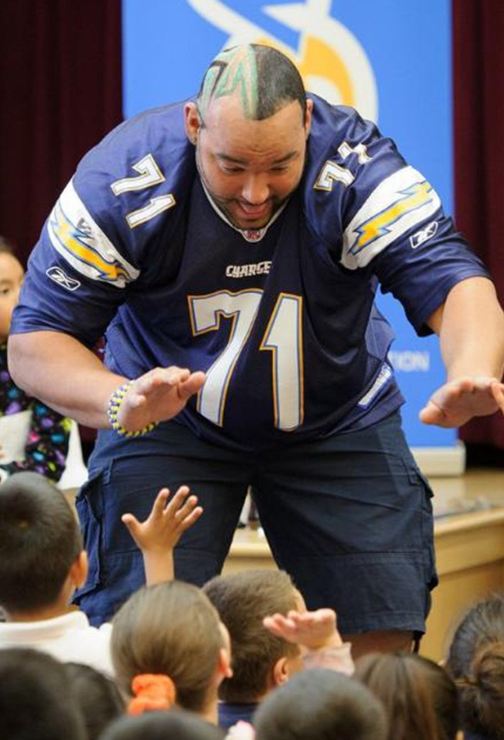
Focusing on Students: ROI
Students get recognition from district and public
Raises positive news about district in Google searches
Associates positive trends in education with district
Engages local community through social media
Provides active outlet for emergency information

Slide 24
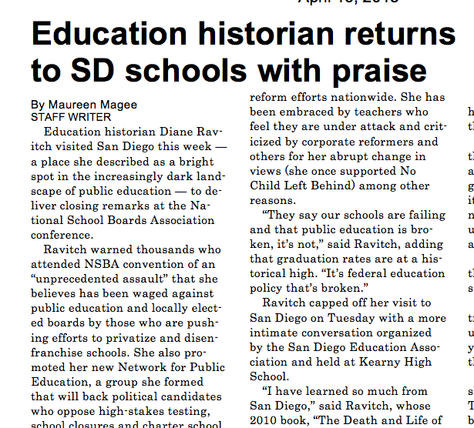
Focusing on Students: ROI
Have statistics available
Helps management understand successes and program objectives
Since social media program began
Two bond issues passed
Parcel tax received 50 percent
Broad Prize nomination
Things to do
Greatschools.org
Realtors
Community fairs
“Latest thing”

Slide 25
Contact Us
Linda Zintz
Director of Communications
619-725-5568
lzintz@sandi.net
Jennifer Cornelius Rodriguez
Specialist
619-725-5598
jcornelius@sandi.net
Jack Brandais
Media Relations
619-725-5570
jbrandais@sandi.net

Slide 26
Comments and Questions

