Slide 1
Revolutionizing
a School District's Marketing Efforts

Slide 2
How can you use content marketing strategies to position your school district’s message, shape parent and community perceptions, and strengthen the organizations brand. Learn how Dallas ISD’s unique communication approach resulted in the creation of a robust online newsroom that tells compelling stories and engages various audiences.

Slide 3
What is content marketing?
Content marketing is a strategic marketing approach focused on creating and distributing valuable, relevant, and consistent content to attract and retain a clearly-defined audience.

Slide 4
OUR CHALLENGE
Mounting negative headlines, loss of voice and lack of message control

Slide 5
Our strategy

Slide 6
Controlled Communication: Provide regularly scheduled and controlled communications that effectively inform audiences about major district initiatives and decisions. Deliver regular high quality news that is timely, relevant, compelling, memorable, meaningful, engaging and cutting edge. We will frame the conversations around Dallas ISD.
Act as News Source: Serve as our own news source and “Break” the news. We will leverage our various communication mediums to get stories out to large readerships. Repeat. Repeat. Repeat.

Slide 7
Create an online newsroom
The Tactic

Slide 8
First Steps
Research
What do we know?
What are the best practices?
What platforms are available?
Who do we want to reach?
Plan
Set goals, objectives, strategies and tactics
Implement
Evaluate

Slide 9
Research
Nine out of ten reporters use the Internet to search for information when they write a story (Sally Falkow)
70 percent of journalists use social networks to assist in reporting (Middleberg Communications/SNCR study)
Best practices include the use of infographics, video content and images
Social media can be used to amplify your content

Slide 10
Planning
Goal
Launch an online newsroom and build awareness among internal and external audiences
Objective
By October 1, 2014, The Hub will launch
By September 2015, Hub traffic will increase by 15 percent compared to September 2014
Strategy
Leverage online tools to position the district as a go-to news source

Slide 11
Alignment with Goals
By 1 September 2015, 65% of community stakeholders are neutral, agree or strongly agree with the direction of the District as measured by a survey conducted by a third party.
By 1 September 2015, 50% of staff agree or strongly agree with the direction of the District as measured by the spring climate survey.

Slide 12
Implementation
Write purpose statement
Bring entire team into alignment
Make a plan
Name the site
Determine platform
Build web navigation
Set expectations
Develop workflow process
Build editorial calendar

Slide 13
Write a purpose statement

Slide 14
Purpose and Intent
The goal of the platform is to serve as the global voice for Dallas Independent School District. The online platform will strive to serve as the primary outlet for compelling, timely, relevant, in-depth, and thoughtful news about the district. Our stories explore news beyond the initial release, digging deeper for our readers. We connect our readers to the work of the district, preparing college- and career-ready students.
We will break our own news.
Our content will be fast to read and hard to forget.
We will give voice to the perspective that is missing in the current conversation about Dallas ISD.
We will tell the untold stories of Dallas ISD.
Compelling Memorable Meaningful Relevant Engaging Cutting Edge

Slide 15
Name the site

Slide 16
Naming the site is key. Options Dallas ISD considered:
Inside Out
SEE Dallas ISD
Show and Tell
Dallas InformED
Frank
Inside Track
Your Page
Story Board

Slide 17
Align team members

Slide 18
Plan the launch

Slide 19
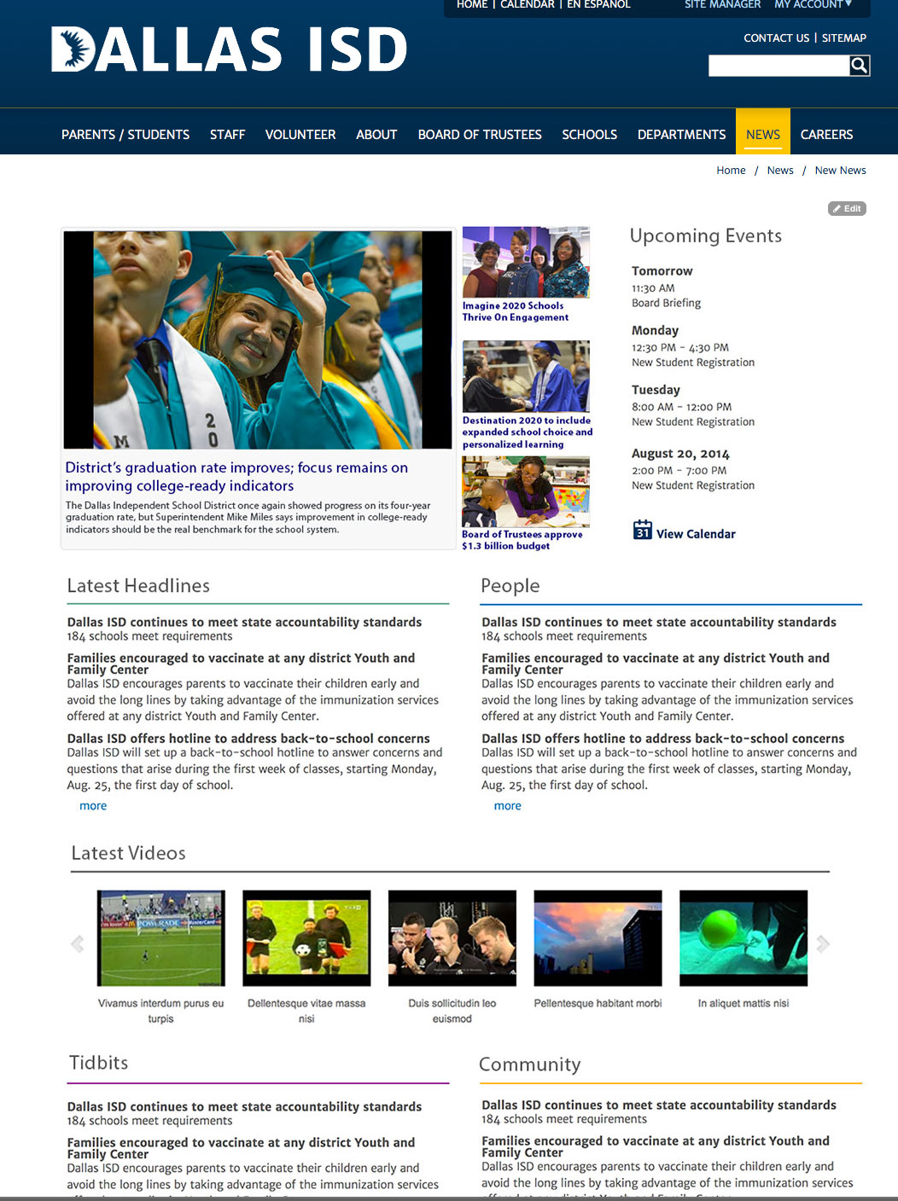
Phase I
As the communication team secures and builds out the most advantageous platform, we are using a transition site built into the existing dallasisd.org website.
ACTIONS
Rethink Content Creation
Establish a Content Generation Process
Launch Weekly Pitch Sessions – Aug 6
Identify Site Categories (Buckets) – Aug 13
Launch Transition Site – Aug 18

Slide 20
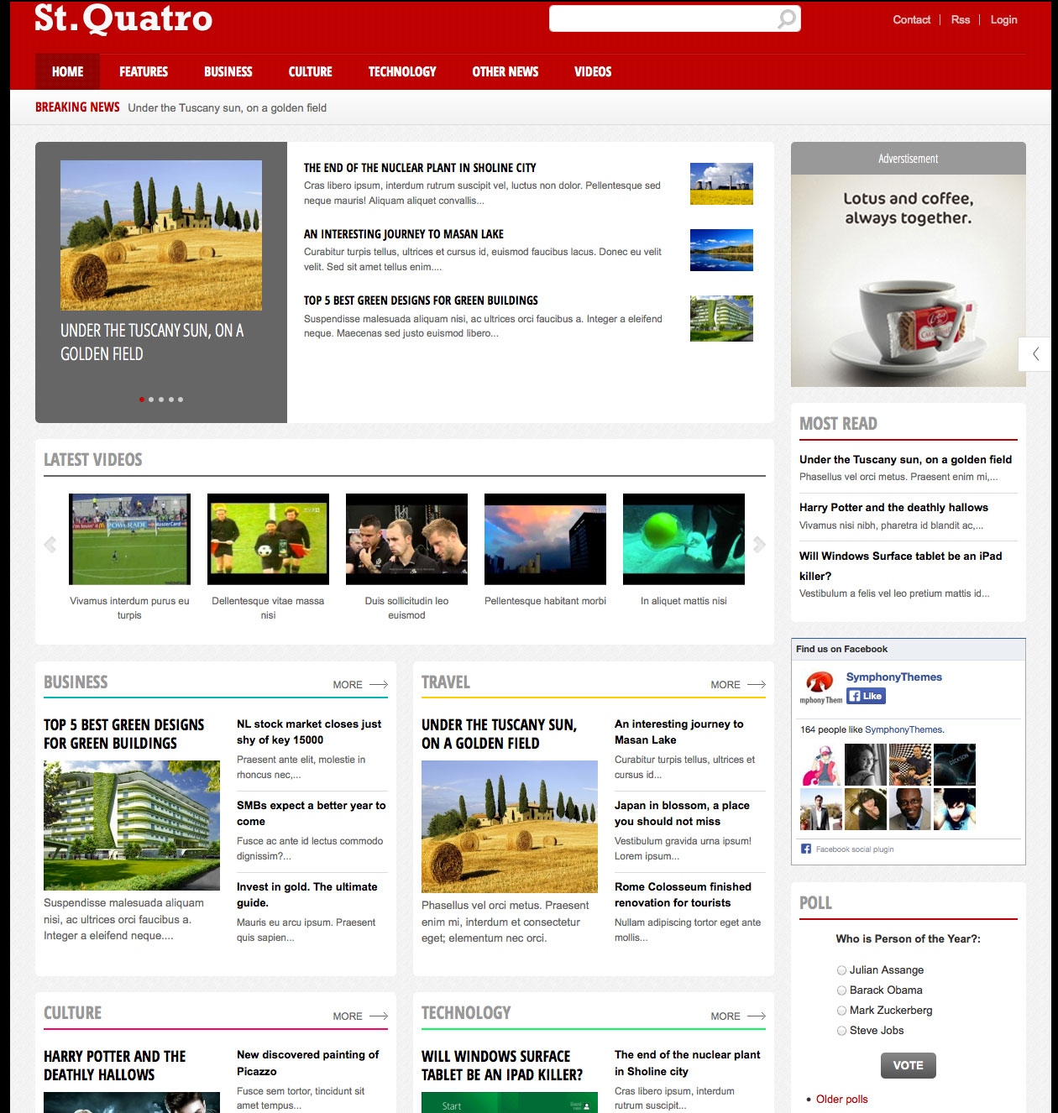
Phase II
Transition content to a robust online newsroom.
ACTIONS
Strengthen Content Creation Process
Template and Required Platform Resources
Procurement of Template
Build Site
Populate Site
Test Site
Launch – NLT October 1

Slide 21
Determine platform build navigation set expectations

Slide 22
What’s New (changes daily)
Headlines (5)
Videos (3) news packages
News Briefs (5)
Inside Dallas ISD (2)
Tidbits (4)
Spanish Language Features (3)
Top 10 Fun Facts What’s Trending

Slide 23
Content Framework
Pitch sessions are held weekly. Communication staff pitch the content pieces (topic, medium and angle) that they want to produce the following week, including identifying the deliverable(s). Sample structure is illustrated below.
August 2014
Monday | Tuesday | Wednesday | Thursday | Friday
4 | 5 Introduce concept | 6 Pitch Session #1 | 7 | 8
11 | 12 | 13 Review Session #1 | 14 | 15 Pitch Session #2
18 | 19 | 20 | 21 | 22 Pitch Session #3
25 | 26 | 27 | 28 | 29 Pitch Session #4
Publishing of stories is scheduled at the conclusion of pitch sessions.
Accepted stories are added to the editorial calendar.
Assignment Editors ensure buckets are filled weekly and publish dates are met.

Slide 24
Develop workflow process

Slide 26
Build editorial calendar

Slide 27
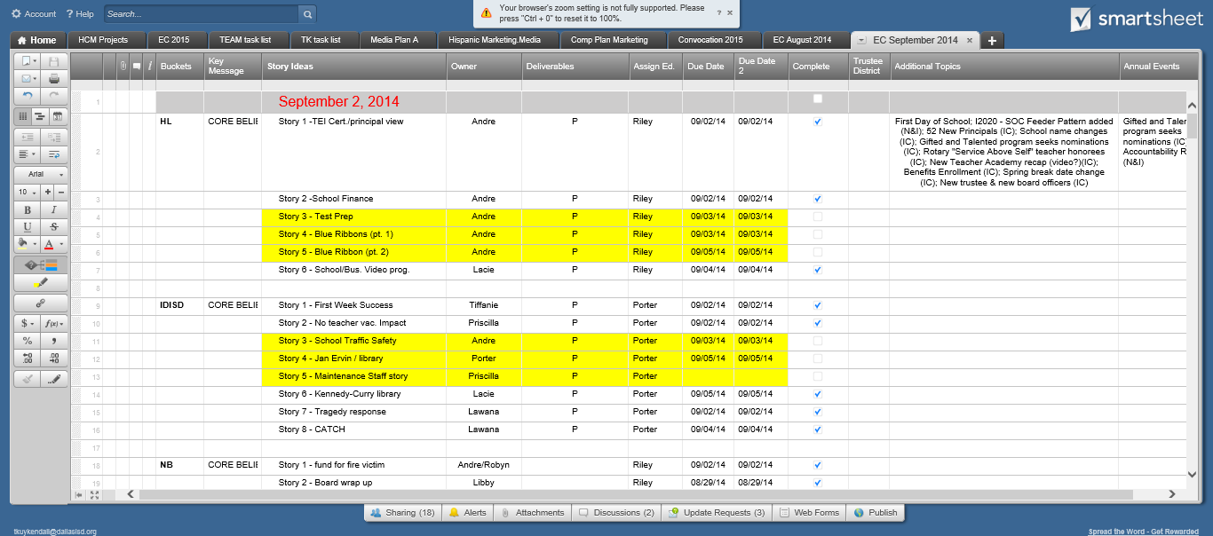
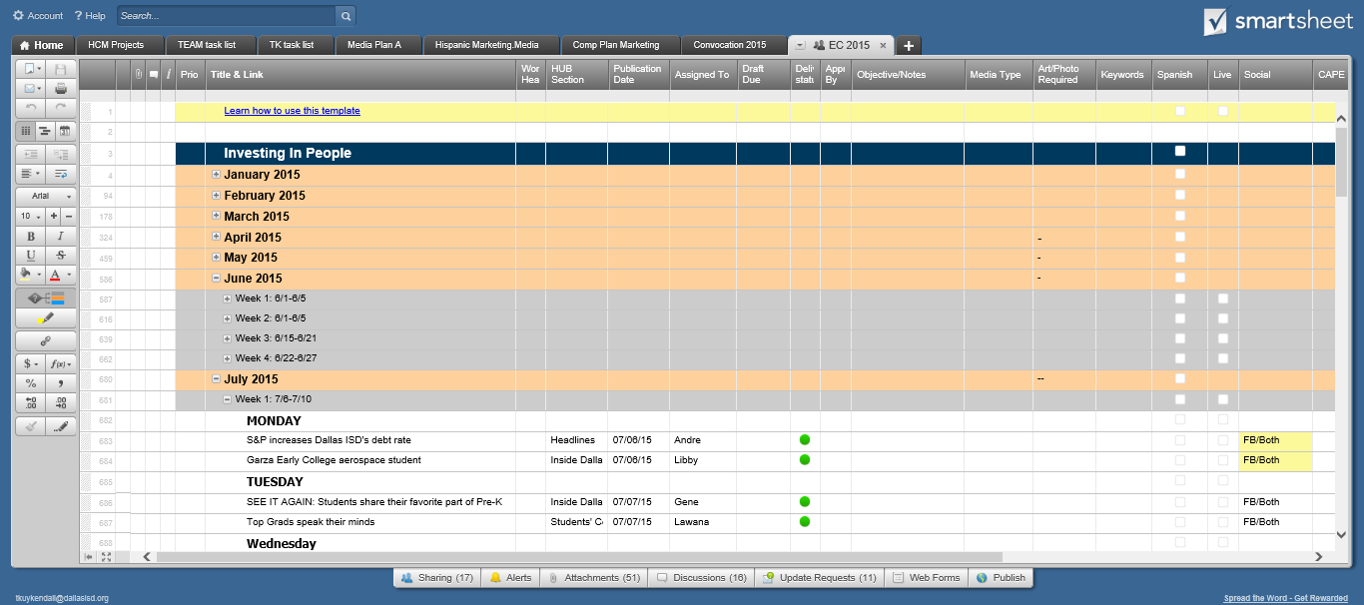

Slide 28
Launch online newsroom

Slide 29
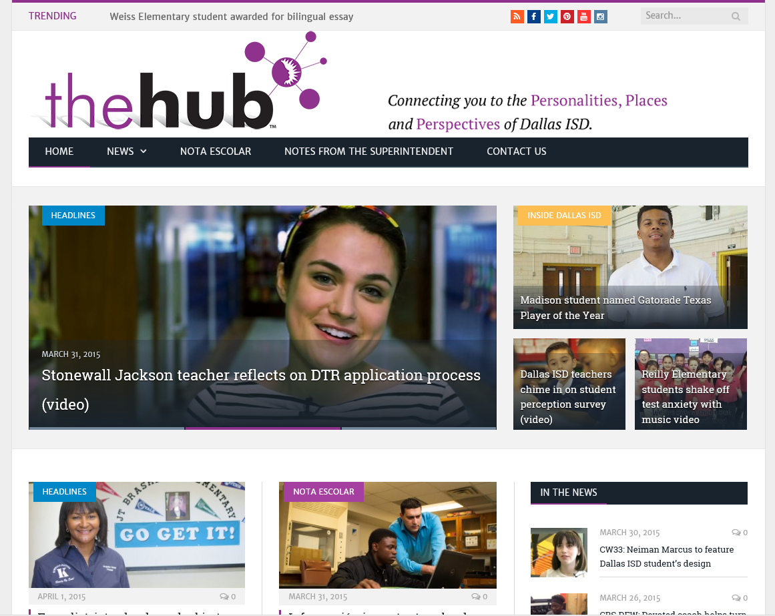

Slide 31
Evaluate efforts

Slide 36
NEXT STEPS
Hub marketing
Refresh the design and layout
Expand content
Create partnerships
Stronger social engagement
Stronger content development

Slide 37
Revolutionizing
a School District's Marketing Efforts
https://drive.google.com/file/d/0B3eybxPQ7wqdVjFaZVZ5OFhsZEk/view?usp=sharing

Slide 38
Links to sample content
https://thehub.dallasisd.org/2015/05/26/summer-learning-labs-reimagine-dallas-isd-summer-school/
https://thehub.dallasisd.org/2015/05/21/dallas-isd-partners-with-smu-for-teacher-professional-development-video/
https://thehub.dallasisd.org/2015/05/19/first-superintendents-scholarship-run-brings-community-together-for-a-cause-video/
https://thehub.dallasisd.org/2015/05/13/parents-pleased-that-students-could-weigh-in-on-teacher-effectiveness-video/
https://thehub.dallasisd.org/2015/05/13/running-for-a-cause-alfredo-ramirez-at-hillcrest-high-school-video/
https://thehub.dallasisd.org/2015/04/24/cigarroa-elementary-volunteer-danae-gutierrez-puts-her-heart-into-everything-video/
https://thehub.dallasisd.org/2015/04/17/u-s-under-secretary-dallas-isd-is-a-leader-in-the-country-in-cafeteria-services/
https://thehub.dallasisd.org/2015/04/08/parents-share-the-benefits-of-their-children-attending-pre-k-video/

