Slide 1
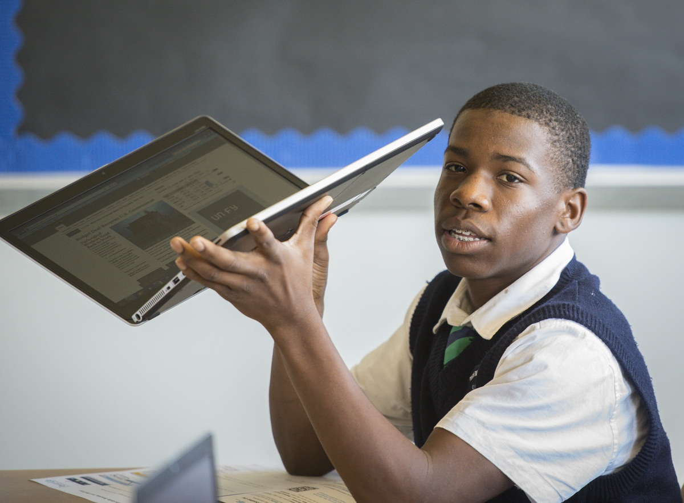
Laptops, Learning, and Connecting the Dots
Houston ID
#greatallover

Slide 2
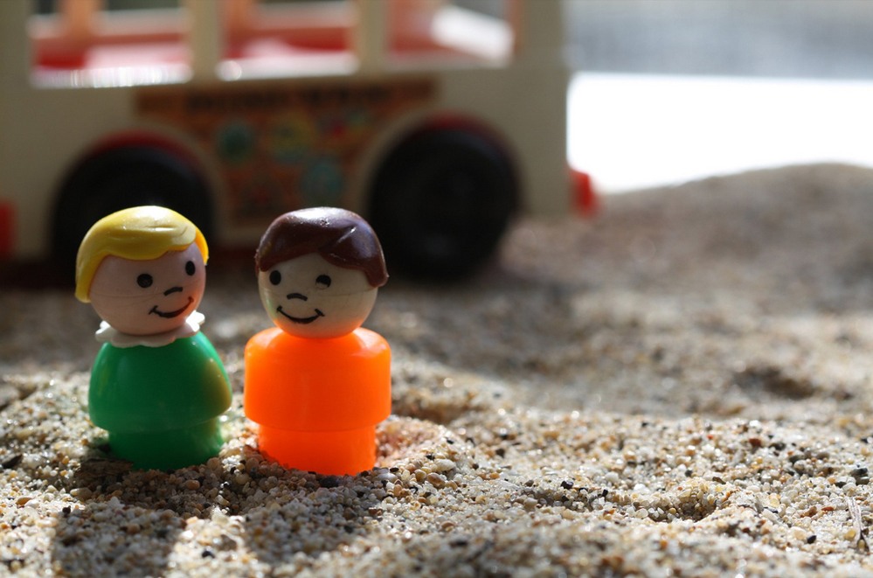
Why Communications Belongs in the Sandbox

Slide 3
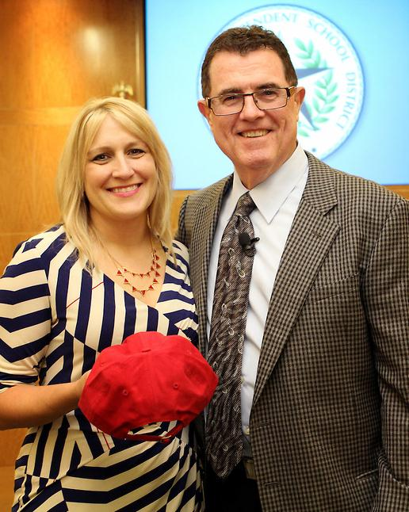
Sarah Greer Osborne General Manager of Communications
282 schools
211,00 students
80% free and reduced lunch
Houston ISD
#greatallover

Slide 4
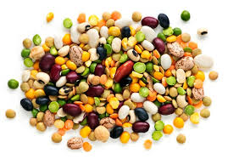
Bold New Initiatives
#greatallover

Slide 5
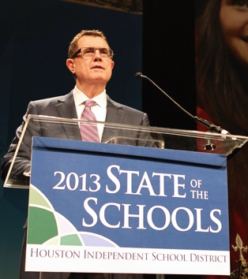
Laptops for All
“With anywhere—anytime learning, our students will have the world at their fingertips. We will make sure they learn the skills that complement technology in order to prevent them from being replaced by technology”
--HISD Superintendent Terry Grier
February 1, 2013

Slide 6
One Year Later
18,000 laptops
11 high schools

Slide 7
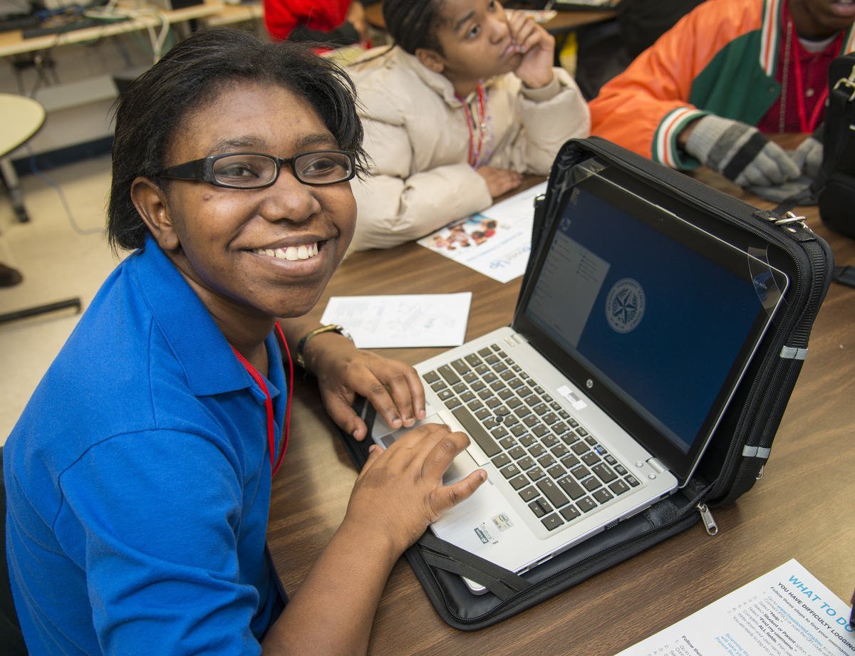
Drama free distribution for
phase one
Positive coverage
locally and nationally
Buy-in from stakeholders
Awards and recognition
Brand recognition

Slide 8
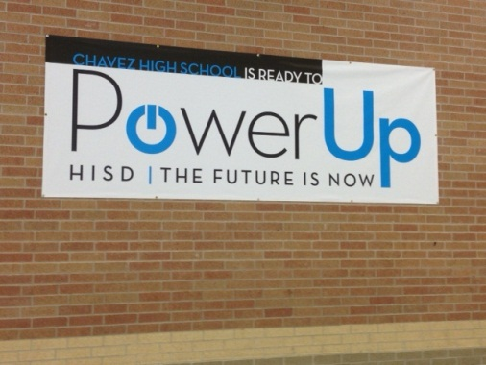
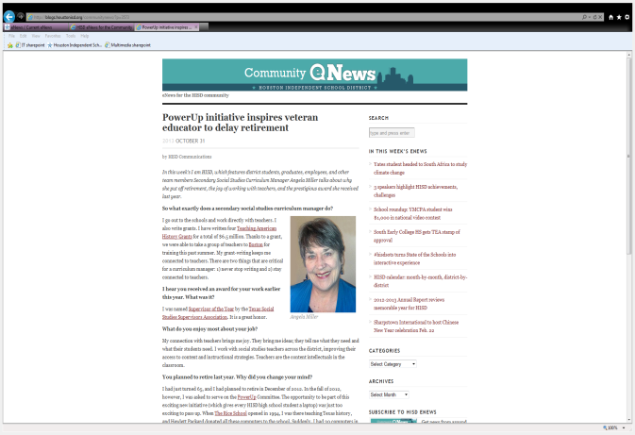
Multifaceted communications effort
Social media
Television
Parent workshops
Teacher blogs
Online resources
Web applications
Electronic newsletters
Emails
Printed collateral
Press conferences
Media availabilities

Slide 9
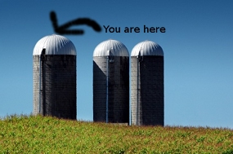
Past District Initiatives
Communications
Everyone else

Slide 10
Time for Communications

Slide 11
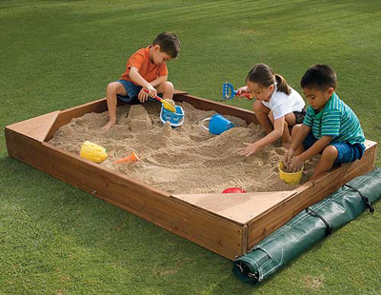
Cross Functional Work Stream
Curriculum
Instructional Technology
Information Technology
Professional Development
Schools Office
COMMUNICATIONS
Notes:
And this is our poster girl, if you will, for that kind of academic success.
Alejandra Ortega graduated in the spring from one of our magnet programs – the Barbara Jordan High School for Careers – and this amazing young woman alone attracted $700,000 in scholarship offers.
She’s the first in her family to attend college, and she’s now in an honors program at the University of Texas.
And the best news for us is that her career goal is to become an educator in HISD.

Slide 12
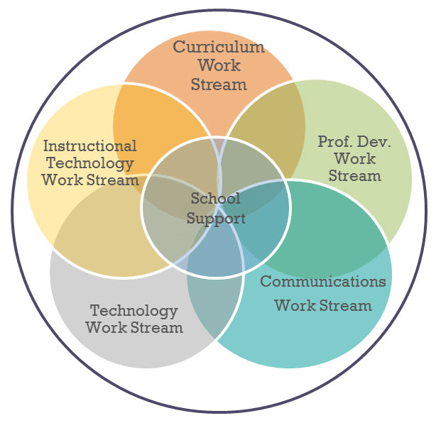
Flower Power

Slide 13
Get in the Sandbox
To build a better sandcastle
To make cleanup easier
To share your toys
Notes:
And this is our poster girl, if you will, for that kind of academic success.
Alejandra Ortega graduated in the spring from one of our magnet programs – the Barbara Jordan High School for Careers – and this amazing young woman alone attracted $700,000 in scholarship offers.
She’s the first in her family to attend college, and she’s now in an honors program at the University of Texas.
And the best news for us is that her career goal is to become an educator in HISD.

Slide 14
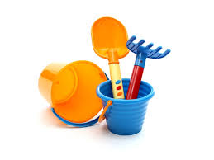
Tools you bring to the box
Why are we dong this?
Who is affected?
What do they need?
What could go wrong?
Notes:
And this is our poster girl, if you will, for that kind of academic success.
Alejandra Ortega graduated in the spring from one of our magnet programs – the Barbara Jordan High School for Careers – and this amazing young woman alone attracted $700,000 in scholarship offers.
She’s the first in her family to attend college, and she’s now in an honors program at the University of Texas.
And the best news for us is that her career goal is to become an educator in HISD.

Slide 15
Don’t be afraid to be…
OF REASON
Notes:
And this is our poster girl, if you will, for that kind of academic success.
Alejandra Ortega graduated in the spring from one of our magnet programs – the Barbara Jordan High School for Careers – and this amazing young woman alone attracted $700,000 in scholarship offers.
She’s the first in her family to attend college, and she’s now in an honors program at the University of Texas.
And the best news for us is that her career goal is to become an educator in HISD.

Slide 16
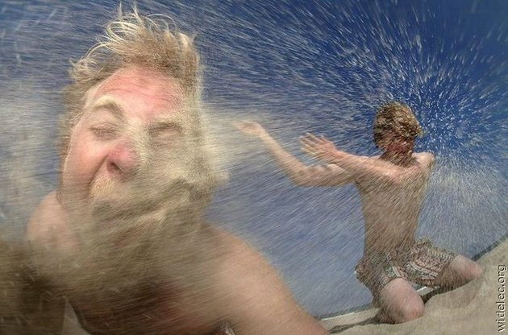
Rules of the Sandbox
Don’t throw sand
Don’t pee in
the box
Give others time
to adjust
Notes:
And this is our poster girl, if you will, for that kind of academic success.
Alejandra Ortega graduated in the spring from one of our magnet programs – the Barbara Jordan High School for Careers – and this amazing young woman alone attracted $700,000 in scholarship offers.
She’s the first in her family to attend college, and she’s now in an honors program at the University of Texas.
And the best news for us is that her career goal is to become an educator in HISD.

Slide 17
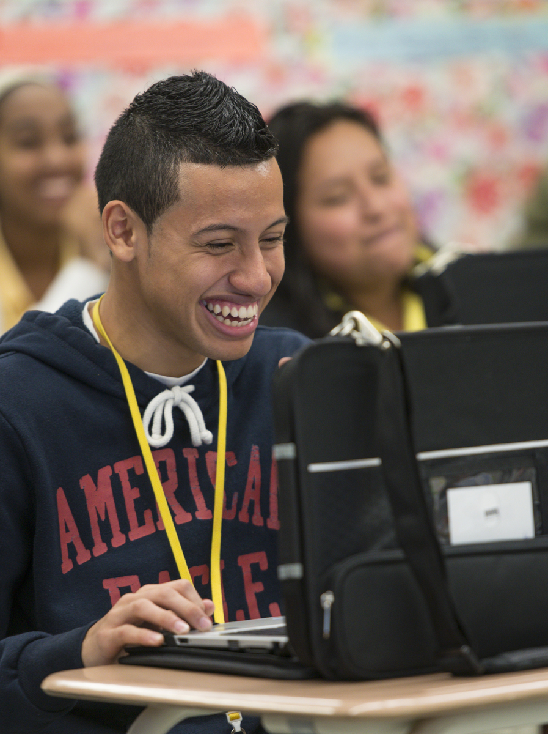
Positive Outcomes
New tools for communication
Drama free implementation
Streamlined communications workflow
New tools for communication
New partners in communication
Prevention of pitfalls
Notes:
Hand-in-hand with a reduction in the dropout rate is an increase in the number of our students who are graduating – now more than three-quarters of them are earning a diploma.

Slide 18
Unexpected Outcomes
New tools for communication
New understanding of
Office of Communications
Most popular girl at the
office
Need to sent boundaries
Notes:
Hand-in-hand with a reduction in the dropout rate is an increase in the number of our students who are graduating – now more than three-quarters of them are earning a diploma.

Slide 19
Questions
Sarah Greer Osborne
General Manager of Communications
Houston ISD
#greatallover

