Slide 1
Three cornerstones:
Student Achievement
Developing Teachers
When students achieve, we all win
Notes:
DAVID
There has been a great deal of interest, excitement and questions about the first year of our Empowering Effective Teachers initiative.
Today is a chance for us to talk about our progress in the first year, and how the initiative is moving forward – and to get your feedback and answer your questions.

Slide 2
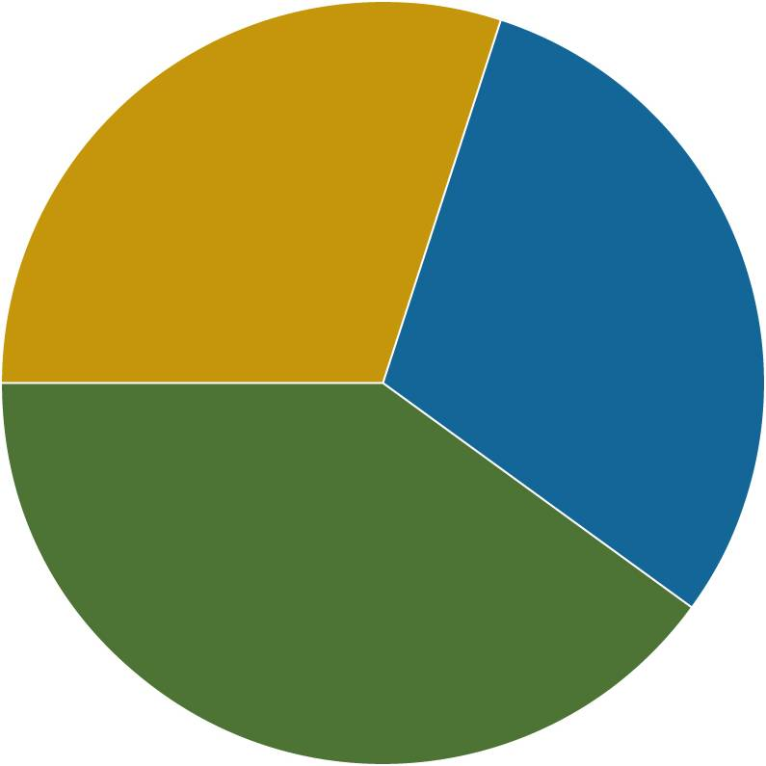
Teacher Evaluations: Multiple Measures Increase Accuracy
Principal’s Written
Evaluation
Principal's Written Evaluation Based Upon Charlotte Danielson’s Frameworks
Mentor/Peer Evaluator's Written Evaluation Based Upon Charlotte Danielson’s Frameworks
30%
30%
30%
100%
40%
Before0%
After
Gains in Student Achievement Based Upon the Calculation of an Experienced Consultant
Teacher evaluations more balanced, meaningful
Notes:
2
ANNA
The evaluation system introduced this year in HCPS is a big departure from what was done in the past. More balanced, with the input from peers. More meaningful.
The peer evaluators have completed 23,000 observation cycles.

Slide 3
Induction for New Teachers….our most significant change
Provide more mentoring support to new teachers
Goal: keep promising new teachers in the district and help them accelerate their professional development. 86% of last year’s first year teachers returned compared to 72% the year before!
Mentors are being selected from among the district’s most effective teachers
Mentors will work with and guide new teachers on a weekly basis for their first two years
Close partnership with the New Teacher Center has accelerated our effectiveness
Supporting teachers as professionals
Notes:
The induction process will provide more mentoring support to new teachers to help them realize their potential.
Goal is to reduce the district’s high attrition rate among new teachers and accelerate their professional development.
Mentors, selected from among the district’s most effective teachers, will work with new teachers on a weekly basis for their first two years to help them improve their instructional skills.

Slide 4
After two years……
Provided more mentoring support to new teachers:
86% of last year’s first year teachers returned, compared to 72% the year before!
Successfully implemented new teacher and principal evaluations.
Peer evaluators received largely positive input from teachers.
Better aligned professional development with the Danielson Framework.
Made changes as needed with input from teachers.
Supporting teachers as professionals
Notes:
Jessica
The induction process will provide more mentoring support to new teachers to help them realize their potential.
Goal is to reduce the district’s high attrition rate among new teachers and accelerate their professional development.
Mentors, selected from among the district’s most effective teachers, will work with new teachers on a weekly basis for their first two years to help them improve their instructional skills.
Whereas mentors serve first and second year teachers, peer evaluators observe and evaluate experienced teachers.

Slide 5
Lessons learned, Modifications made along the way
Expanded the evaluation process to include new groups such as counselors, media specialists, adult education teachers, pre-K teachers, and technology resource specialists.
Increased the number of mentors to 70 so that second year teachers would receive support.
Increased the number of peers to 123 in order to lower their caseloads.
Reviewed and modified the teacher evaluation rubric.
Changed the observation schedule to include informal observations.
Changed weighting of peer and principal evaluations.
Supporting teachers as professionals
Notes:
Jessica
The induction process will provide more mentoring support to new teachers to help them realize their potential.
Goal is to reduce the district’s high attrition rate among new teachers and accelerate their professional development.
Mentors, selected from among the district’s most effective teachers, will work with new teachers on a weekly basis for their first two years to help them improve their instructional skills.
Whereas mentors serve first and second year teachers, peer evaluators observe and evaluate experienced teachers.

Slide 6
New Directions from the MET Project
Video Captures and Teacher Reflections
Student Surveys for Professional Development
Measures of Effective Teaching

Slide 7
Email us at: greatteachers@sdhc.k12.fl.us
Or visit us on the website:
empoweringteachers.mysdhc.org
David.steele@sdhc.k12.fl.us
Danni.resnick@sdhc.k12.fl.us
When students succeed, we all win
Notes:
ANNA
And now, I’d welcome any comments or questions….

