Slide 2
Fort Worth ISD is committed to helping our students stay safe.
The "It's Not Okay!" campaign encourages students to make healthy decisions and ask for help when they or their friends are in need.

Slide 3
The Fort Worth ISD wants students to know that
“It’s Not Okay” for anyone to be a victim of:
Bullying
Cyberbullying
Teen dating violence
Sexting
Suicide
Gangs
Sexual harassment
Substance abuse

Slide 4
Fort Worth ISD and parents want elementary school children to know It’s Not Okay to be a victim of:
Bullying
Cheating
Disrespect
Lying
Hurting Yourself
Substance Abuse
Cyberbullying
Being mean

Slide 5
Multi-tiered, comprehensive program
Community-wide campaign
to raise awareness
K-12 ‘whole-school’ initiative
Resources for students
and parents/adults

Slide 6
We named it.
or

Slide 7
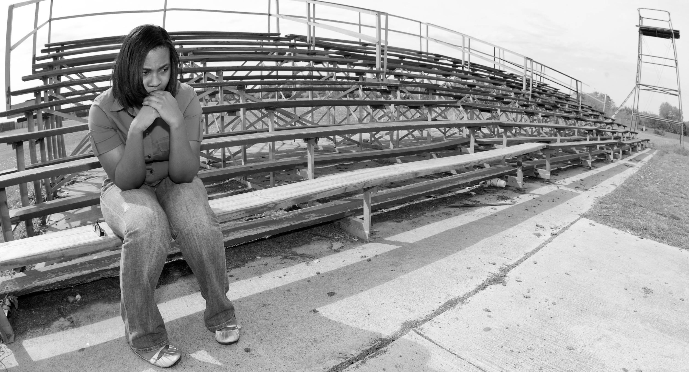
We let the kids drive the bus.

Slide 8
Students contributed to language used on the poster – and selected the fonts.

Slide 9
The aesthetics were designed to appeal to a young demographic

Slide 10
We collaborated internally.
Guidance and Counseling
Intervention Services
School Leadership
Communications

Slide 11
We identified and
collaborated with other
entities, especially
Safe Cities Commission – underwrites cost of billboards
Crimestoppers

Slide 12
We provided resources for parents, kids
and educators.
Website
Teacher tips and parent tips
Overview manual

Slide 13
Implementation Plan for Campuses
INOK Committee
Student Committee
Pledge Cards
Posters, banners
Handouts for faculty meetings
Dedicated time at faculty meetings

Slide 14
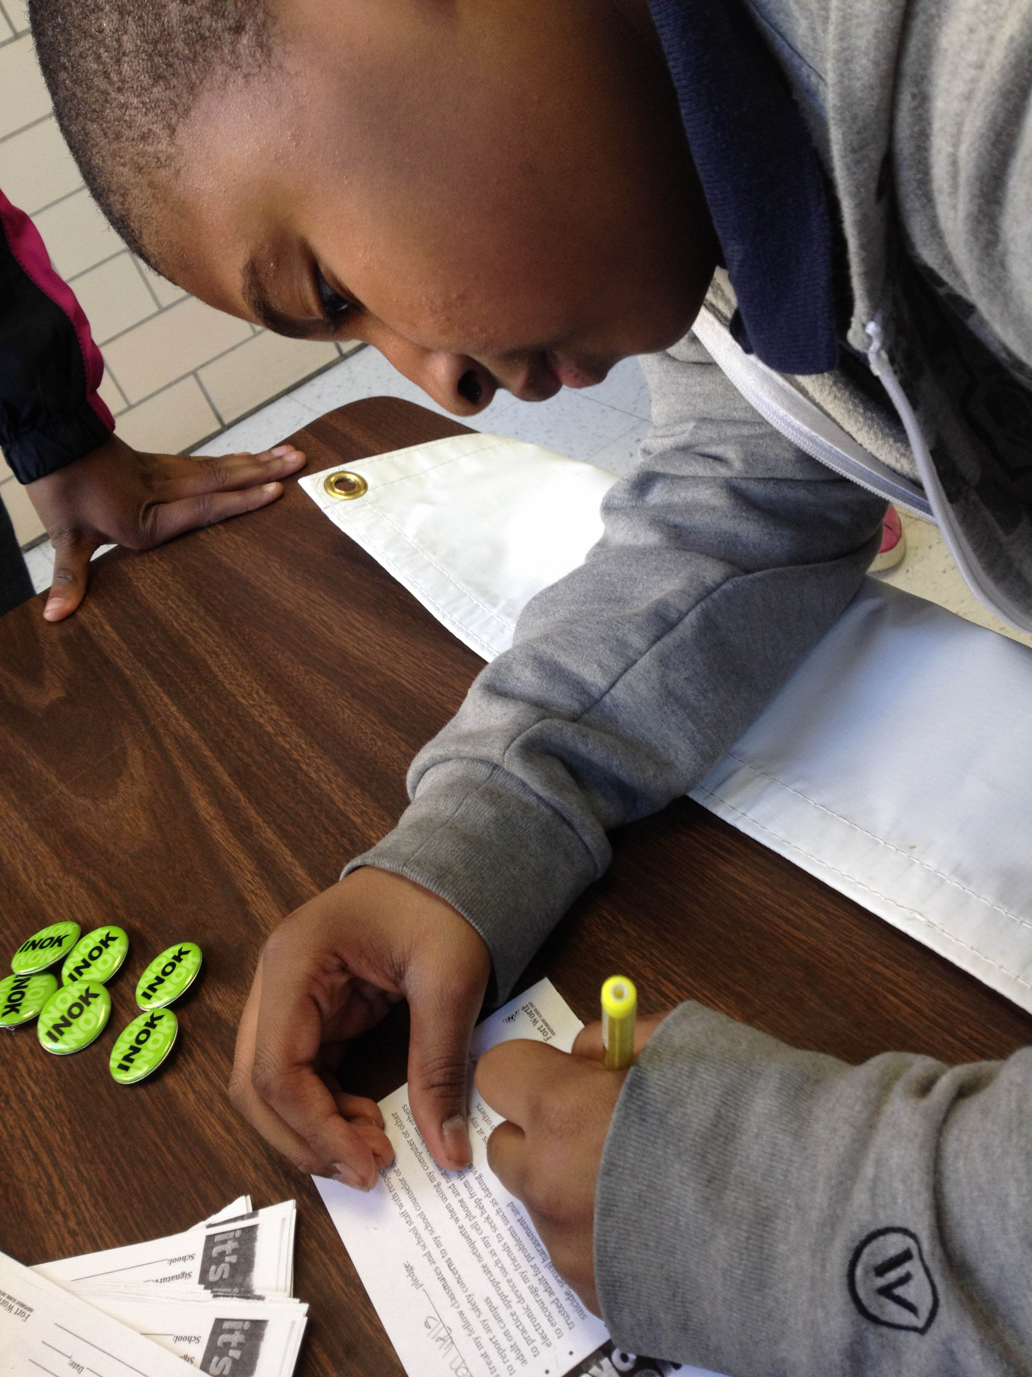
Campus-specific events promoted awareness and celebrated positive choices.

Slide 15
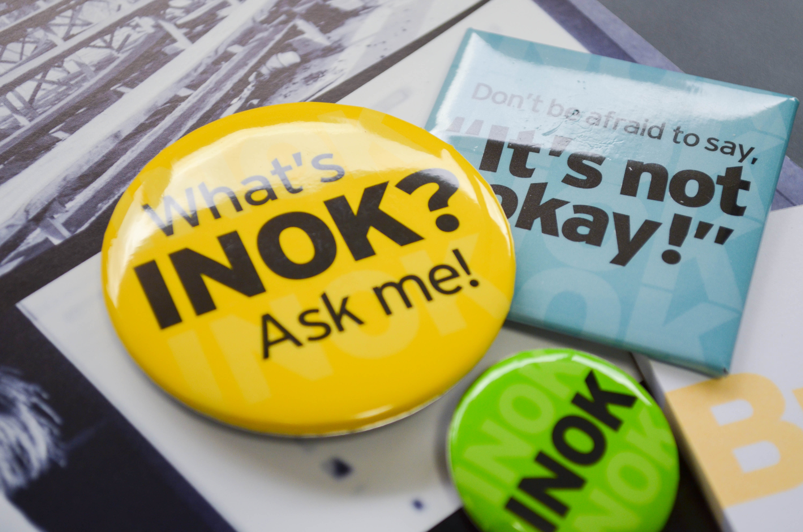
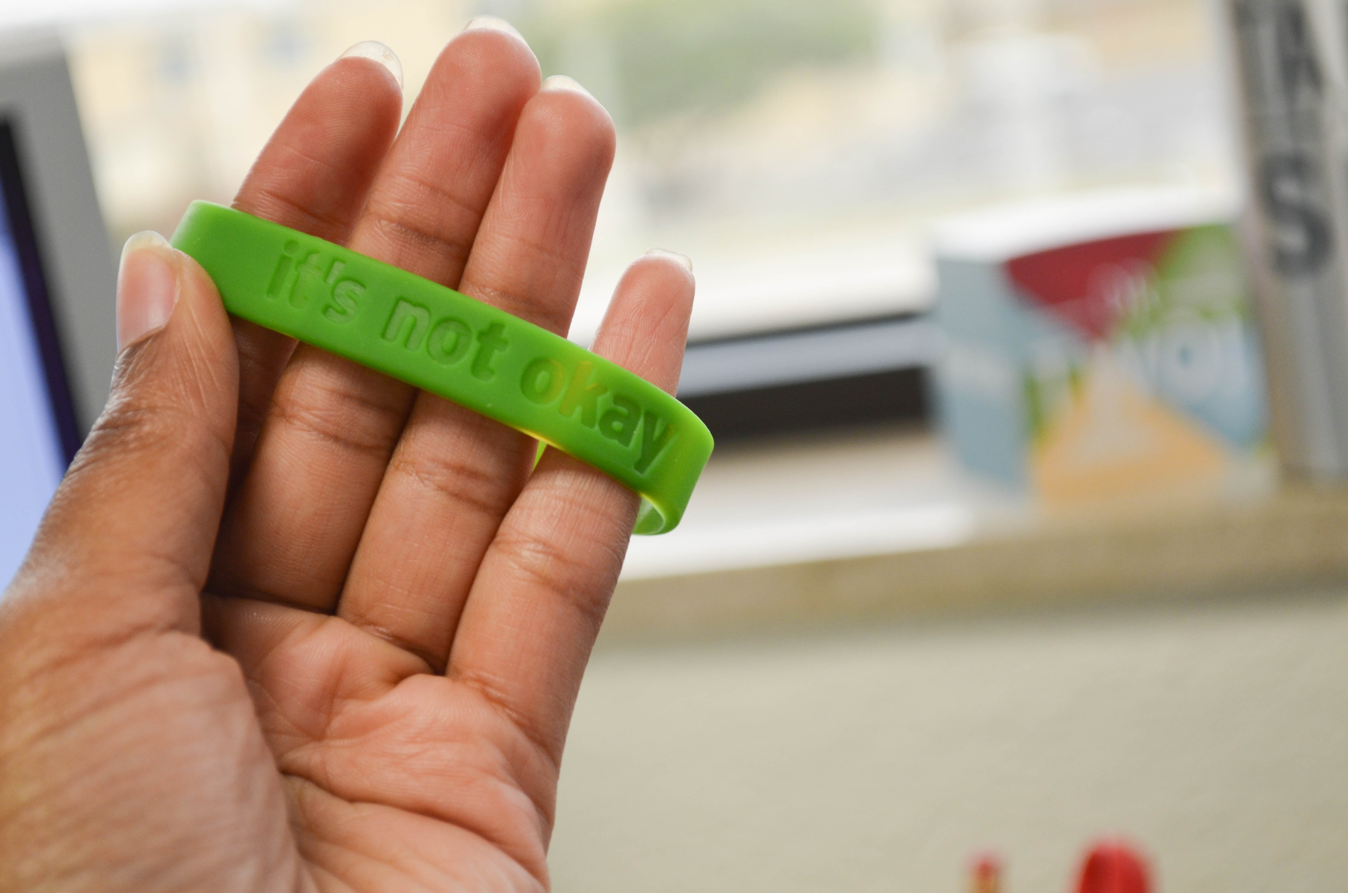
We created lots of swag – and rewarded
students with the items.

Slide 16
We encouraged teachers to incorporate the
message in existing curriculum – rather than add
another independent area of study.
“Nay, as they dare. I will bite my thumb at them; which is a disgrace to them, if they bear it.”
Romeo and Juliet, Act 1, Scene I.

Slide 17
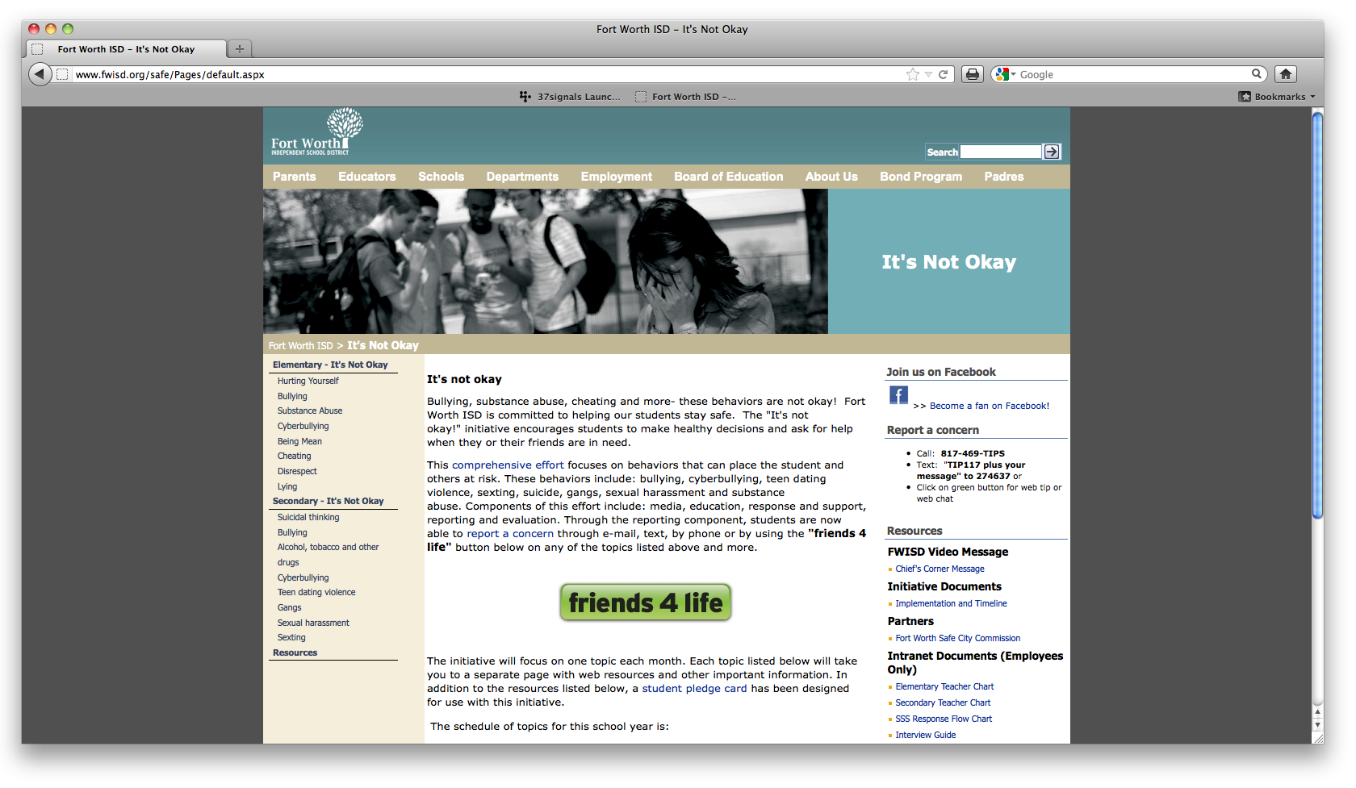
We embraced technology.
Tools for action:
Web
Phone
E-mail
Text-messaging

Slide 18
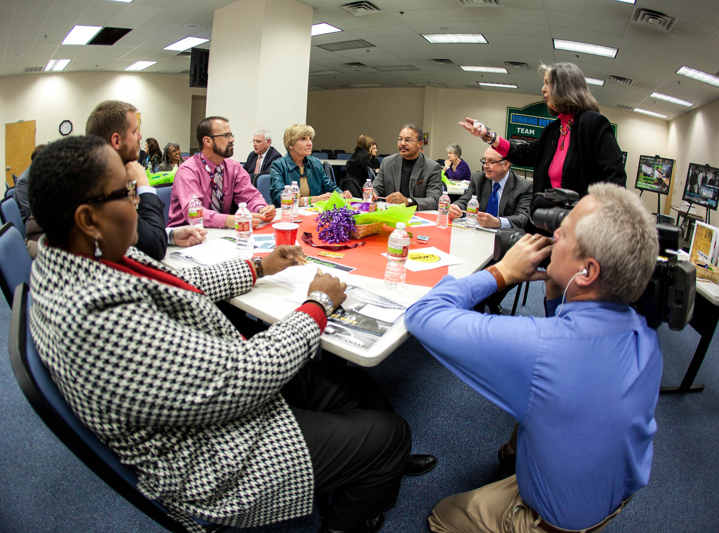
Community-wide Kick-
Off – January, 2012
Attended by the Mayor, the
Police Chief, the Fire Chief,
various City Council members
and a host of others

Slide 19
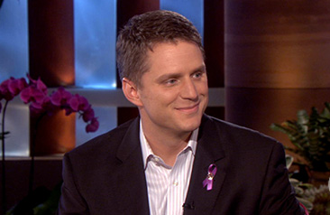
We got a champion.
Fort Worth City Councilman Joel Burns gained national attention after speaking during a Fort Worth City Council meeting about his own experiences.

Slide 20
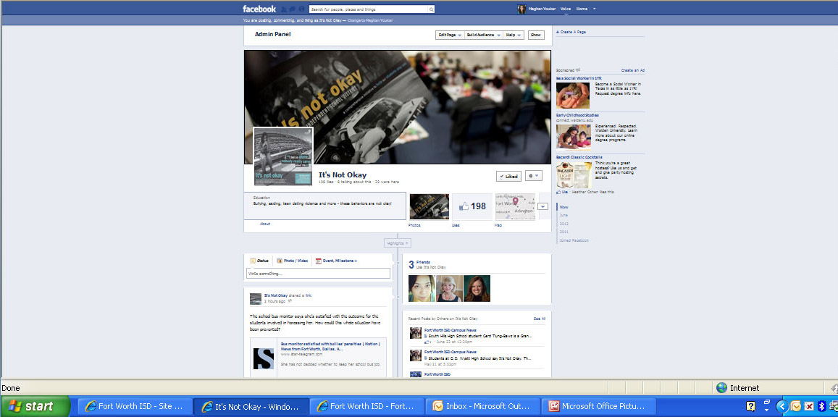
We used social media.

Slide 21
We measured our success.
Fort Worth elementary students say:
Almost half -- 43.6% -- of students agree that they know a student who has been bullied.
However, generally, students feel safe at school and know who to talk to if they are bullied.
Fort Worth secondary students say:
Physical bullying remains unchanged
Internet bullying is up almost 30% from the previous year
Verbal bullying is down nearly 20%

Slide 22
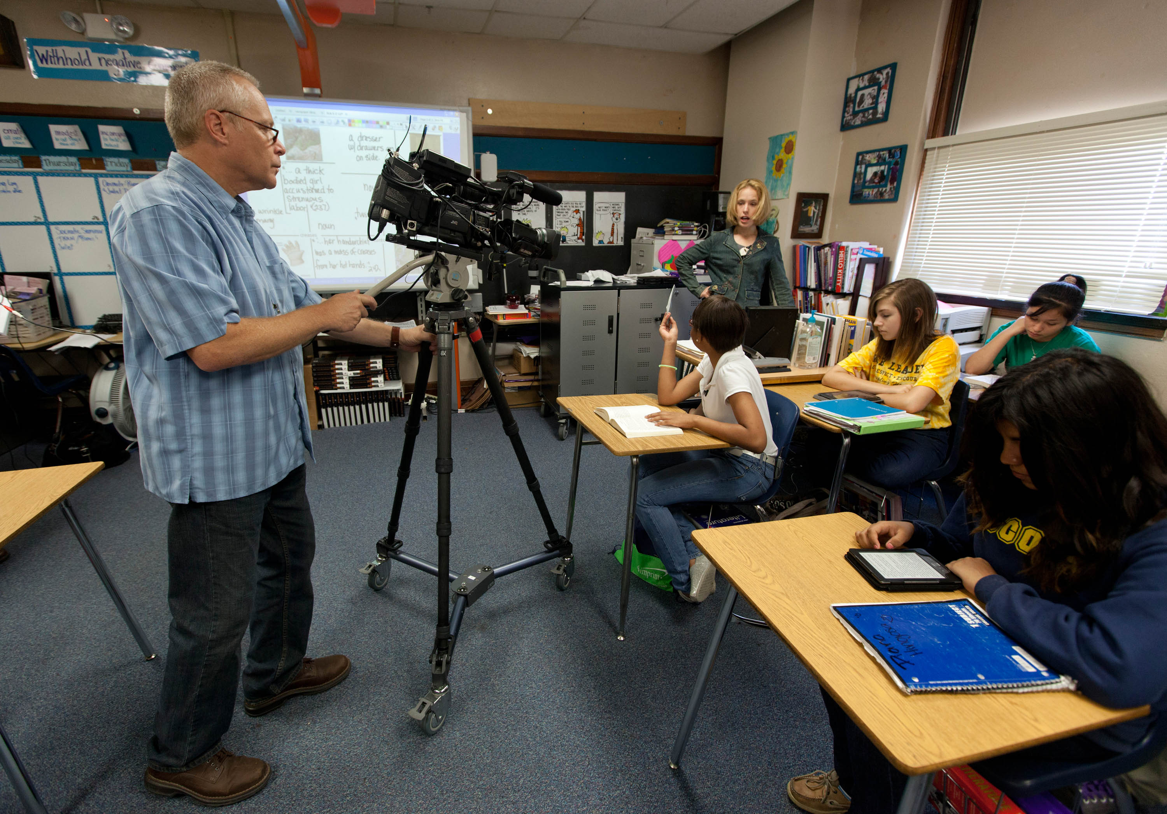
It’s Not Okay,
the Movie
Students want better role models
Adults want more respectful peers
Everyone has a story

